Slide 1
Project Scheduling:
Network Diagrams

Slide 2
PROJECT SCHEDULING
Scope Management
  Work Breakdown Structure
    Deliverables
      Work Packages
        Activities
Project scheduling requires us to follow some carefully laid-out steps, in order, for the schedule to take shape - to present linked activities with planned dates, durations, milestones, and resources.

Slide 3
PROJECT SCHEDULING
Project planning as it relates to the scheduling process, has been defined by the PMBoK as:
The identification of the project objectives and the ordered activity necessary to complete the project including the identification of resource types and quantities required to carry out each activity or task.

Slide 4
PROJECT SCHEDULING
Project scheduling techniques lie at the heart of project planning and subsequent monitoring and control
Project scheduling represents the conversion of project goals into an achievable methodology for their completion; a timetable and the network logic that relates project activities to each other in a coherent fashion
Project scheduling defines network logic for all activities: tasks that must either precede or follow other tasks from the beginning of the project to completion

Slide 5
PROJECT SCHEDULING
Project scheduling can take a lot of time and effort, but when done well…
Clearly illustrates the interdependence of all tasks and work packages
Facilitates communication flow
Helps with master scheduling of organisational resources
Identified critical activities & distinguishes them from the less critical
Provides expectation for when the project will be completed & dates on which various project activities must start and end
Helps with coordination of activities that are dependent
on each other

Slide 6
EXAMPLE
Project = research project (paper and presentation)
What steps do we need to complete?
What order do they need to be completed in?

Slide 7
EXAMPLE
Project = research project (paper and presentation)
Identify the topic
Research the topic
Write the first draft of the paper
Edit and rewrite the paper
Prepare a class presentation
Complete the final draft of the paper
Complete the presentation
Hand in the paper and present the topic in class

Slide 8
Identify the topic
Research the topic
Write the first draft of the paper
Edit and rewrite the paper
Prepare a class presentation
Complete the final draft of the paper
Complete the presentation
Hand in the paper and present the topic in class
EXAMPLE

Slide 9
Identify the topic
Research the topic
Write the first draft of the paper
Edit and rewrite the paper
Prepare a class presentation
Complete the final draft of the paper
Complete the presentation
Hand in the paper and present the topic in class
EXAMPLE
Identify topic
Research topic
Edit & rewrite
First draft
Prepare presentation
Complete final draft
Complete presentation
Hand in paper & present

Slide 10
Identify the topic
Research the topic
Write the first draft of the paper
Edit and rewrite the paper
Prepare a class presentation
Complete the final draft of the paper
Complete the presentation
Hand in the paper and present the topic in class
EXAMPLE
Identify topic
Research topic
First draft

Slide 11
Identify the topic
Research the topic
Write the first draft of the paper
Edit and rewrite the paper
Prepare a class presentation
Complete the final draft of the paper
Complete the presentation
Hand in the paper and present the topic in class
EXAMPLE
Edit & rewrite
Complete final draft
Identify topic
Research topic
First draft
Prepare presentation
Complete presentation

Slide 12
Identify the topic
Research the topic
Write the first draft of the paper
Edit and rewrite the paper
Prepare a class presentation
Complete the final draft of the paper
Complete the presentation
Hand in the paper and present the topic in class
EXAMPLE
Edit & rewrite
Complete final draft
Identify topic
Research topic
First draft
Prepare presentation
Complete presentation

Slide 13
Identify the topic
Research the topic
Write the first draft of the paper
Edit and rewrite the paper
Prepare a class presentation
Complete the final draft of the paper
Complete the presentation
Hand in the paper and present the topic in class
EXAMPLE
Edit & rewrite
Complete final draft
Hand in paper & present
Identify topic
Research topic
First draft
Prepare presentation
Complete presentation

Slide 14
Identify the topic
Research the topic
Write the first draft of the paper
Edit and rewrite the paper
Prepare a class presentation
Complete the final draft of the paper
Complete the presentation
Hand in the paper and present the topic in class
When the nature of the work allows for more than one activity to be accomplished at the same time, these activities are called concurrent, and parallel project paths are constructed through the network.
EXAMPLE
Edit & rewrite
Complete final draft
Hand in paper & present
Identify topic
Research topic
First draft
Prepare presentation
Complete presentation

Slide 15
TERMINOLOGY
Project network – a visual flow diagram developed from the WBS
Activity – an element in the project that consumes time
Parallel activities – can take place at the same time
Serial activities – those that flow from one to the next, in sequence
Merge activity – has more than one activity immediately preceding it
Burst activity – has more than one activity immediately following it
Event – term used to represent a point in time when an activity starts or ends. It does not consume time
Path – a sequence of connected, dependent activities
Critical path – the path with the longest duration, which determines the shortest project length

Slide 16
Project Network
Edit & rewrite
Complete final draft
Hand in paper & present
Identify topic
Research topic
First draft
Prepare presentation
Complete presentation
Notes:
Here we see a project network [click], which is the whole visual of the project
And we have each of these rectangles or nodes as activities.
We have a burst activity [click], where more than one activity immediately follows, and a merga ctivity [click] where more than one activity immediately precedes. And we’ll need to be able to recognise these activities when we start including timing for scheduling in our networks, which we’ll do in our second video..
And again, as we saw in the first example of thise project [click] we have some serial activities here – those activities that simply follow one after the other.

Slide 17
Project Network
Edit & rewrite
Complete final draft
Activity
Hand in paper & present
Identify topic
Research topic
First draft
Prepare presentation
Complete presentation
Notes:
Here we see a project network [click], which is the whole visual of the project
And we have each of these rectangles or nodes as activities.
We have a burst activity [click], where more than one activity immediately follows, and a merga ctivity [click] where more than one activity immediately precedes. And we’ll need to be able to recognise these activities when we start including timing for scheduling in our networks, which we’ll do in our second video..
And again, as we saw in the first example of thise project [click] we have some serial activities here – those activities that simply follow one after the other.

Slide 18
Project Network
Burst
Activity
Edit & rewrite
Complete final draft
Activity
Hand in paper & present
Identify topic
Research topic
First draft
Prepare presentation
Complete presentation
Notes:
Here we see a project network [click], which is the whole visual of the project
And we have each of these rectangles or nodes as activities.
We have a burst activity [click], where more than one activity immediately follows, and a merga ctivity [click] where more than one activity immediately precedes. And we’ll need to be able to recognise these activities when we start including timing for scheduling in our networks, which we’ll do in our second video..
And again, as we saw in the first example of thise project [click] we have some serial activities here – those activities that simply follow one after the other.

Slide 19
Project Network
Burst
Activity
Merge Activity
Edit & rewrite
Complete final draft
Activity
Hand in paper & present
Identify topic
Research topic
First draft
Prepare presentation
Complete presentation
Notes:
Here we see a project network [click], which is the whole visual of the project
And we have each of these rectangles or nodes as activities.
We have a burst activity [click], where more than one activity immediately follows, and a merga ctivity [click] where more than one activity immediately precedes. And we’ll need to be able to recognise these activities when we start including timing for scheduling in our networks, which we’ll do in our second video..
And again, as we saw in the first example of thise project [click] we have some serial activities here – those activities that simply follow one after the other.

Slide 20
Project Network
Burst
Activity
Merge Activity
Edit & rewrite
Complete final draft
Activity
Hand in paper & present
Identify topic
Research topic
First draft
Prepare presentation
Complete presentation
Serial Activities
Notes:
Here we see a project network [click], which is the whole visual of the project
And we have each of these rectangles or nodes as activities.
We have a burst activity [click], where more than one activity immediately follows, and a merga ctivity [click] where more than one activity immediately precedes. And we’ll need to be able to recognise these activities when we start including timing for scheduling in our networks, which we’ll do in our second video..
And again, as we saw in the first example of thise project [click] we have some serial activities here – those activities that simply follow one after the other.

Slide 21
Project Network
Edit & rewrite
Complete final draft
Hand in paper & present
Identify topic
Research topic
First draft
Prepare presentation
Complete presentation
Notes:
Here we see a project network [click], which is the whole visual of the project
And we have each of these rectangles or nodes as activities.
We have a burst activity [click], where more than one activity immediately follows, and a merga ctivity [click] where more than one activity immediately precedes. And we’ll need to be able to recognise these activities when we start including timing for scheduling in our networks, which we’ll do in our second video..
And again, as we saw in the first example of thise project [click] we have some serial activities here – those activities that simply follow one after the other.

Slide 22
Project Network
Edit & rewrite
Complete final draft
Hand in paper & present
Identify topic
Research topic
First draft
Prepare presentation
Complete presentation
Parallel Activities
Notes:
Here we see a project network [click], which is the whole visual of the project
And we have each of these rectangles or nodes as activities.
We have a burst activity [click], where more than one activity immediately follows, and a merga ctivity [click] where more than one activity immediately precedes. And we’ll need to be able to recognise these activities when we start including timing for scheduling in our networks, which we’ll do in our second video..
And again, as we saw in the first example of thise project [click] we have some serial activities here – those activities that simply follow one after the other.

Slide 23
Project Network
Edit & rewrite
Complete final draft
Path 1
Hand in paper & present
Identify topic
Research topic
First draft
Prepare presentation
Complete presentation
Parallel Activities
Notes:
Here we see a project network [click], which is the whole visual of the project
And we have each of these rectangles or nodes as activities.
We have a burst activity [click], where more than one activity immediately follows, and a merga ctivity [click] where more than one activity immediately precedes. And we’ll need to be able to recognise these activities when we start including timing for scheduling in our networks, which we’ll do in our second video..
And again, as we saw in the first example of thise project [click] we have some serial activities here – those activities that simply follow one after the other.

Slide 24
Project Network
Edit & rewrite
Complete final draft
Path 1
Hand in paper & present
Identify topic
Research topic
First draft
Path 2
Prepare presentation
Complete presentation
Parallel Activities
Notes:
Here we see a project network [click], which is the whole visual of the project
And we have each of these rectangles or nodes as activities.
We have a burst activity [click], where more than one activity immediately follows, and a merga ctivity [click] where more than one activity immediately precedes. And we’ll need to be able to recognise these activities when we start including timing for scheduling in our networks, which we’ll do in our second video..
And again, as we saw in the first example of thise project [click] we have some serial activities here – those activities that simply follow one after the other.

Slide 25
Project Scheduling:
Activity on Node Network Diagrams

Slide 26
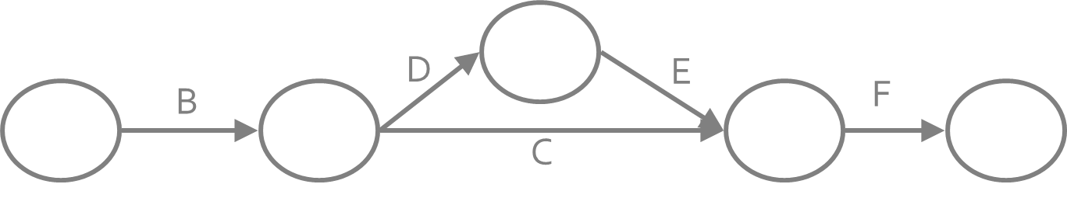
NETWORK DIAGRAMS
Two common approaches: AOA and AON
Both use the arrow and the node as building blocks
Activities represented by letters
AOA – arrows depict the activities

Slide 27
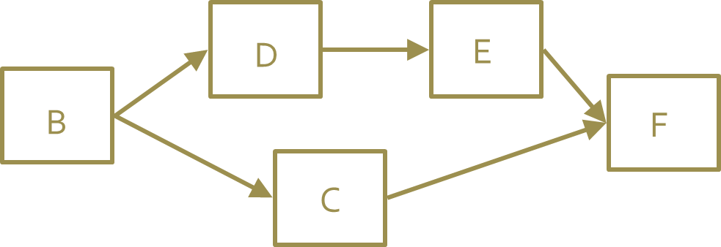
NETWORK DIAGRAMS
Two common approaches: AOA and AON
Both use the arrow and the node as building blocks
Activities represented by letters
AOA – arrows depict the activities
AON – nodes depict the activities

Slide 28
ACTIVITY ON NODE
In practice, AON has come to dominate
Activities represented by nodes
Arrows are merely connection
devices – simplified network labeling
Easy to read & comprehend, even for novice project managers
Primary drawback – as the project becomes more complex the sheer number of arrows or nodes can become “messy”

Slide 29
ACTIVITY ON NODE -FUNDAMENTALS
Predecessors: Those activities that must be completed prior to initiation of a later activity in the network.
Successors: Activities that cannot be started until previous activities have been completed. These activities follow predecessor tasks.

Slide 30
ACTIVITY ON NODE - FUNDAMENTALS
A
B
C
A is preceded by nothing
B is preceded by A
C is preceded by B

Slide 31
ACTIVITY ON NODE - FUNDAMENTALS
Y
X
Y and Z are preceded by X
Y and Z can start at the same time if you wish
Z

Slide 32
ACTIVITY ON NODE - FUNDAMENTALS
J
J, K, and L can all start at the same time if you wish
(J, K, and L do not need to occur simultaneously)
BUT
J, K, and L must ALL finish before M can start
K
M
L

Slide 33
ACTIVITY ON NODE – NETWORK DIAGRAM RULES
Some determination of activity precedence ordering must be done prior to creating the network (i.e., logically linking, successor, etc.)
Flow: left to right
An activity cannot begin until all preceding connected activities have been completed
Arrows on networks indicate precedence and logical flow. Arrows can cross over each other (but not recommended)
Unique identifier needed for each activity
Looping (or recycling) through activities is not permitted
Good to start and end with a single node (but not required)

Slide 34
ACTIVITY ON NODE – THE NODE
Early Start (ES)
Unique Identifier (ID)
Early Finish (EF)
Float (or Slack)
Activity Description
Late Start (LS)
Duration
Late Finish (LF)

Slide 35
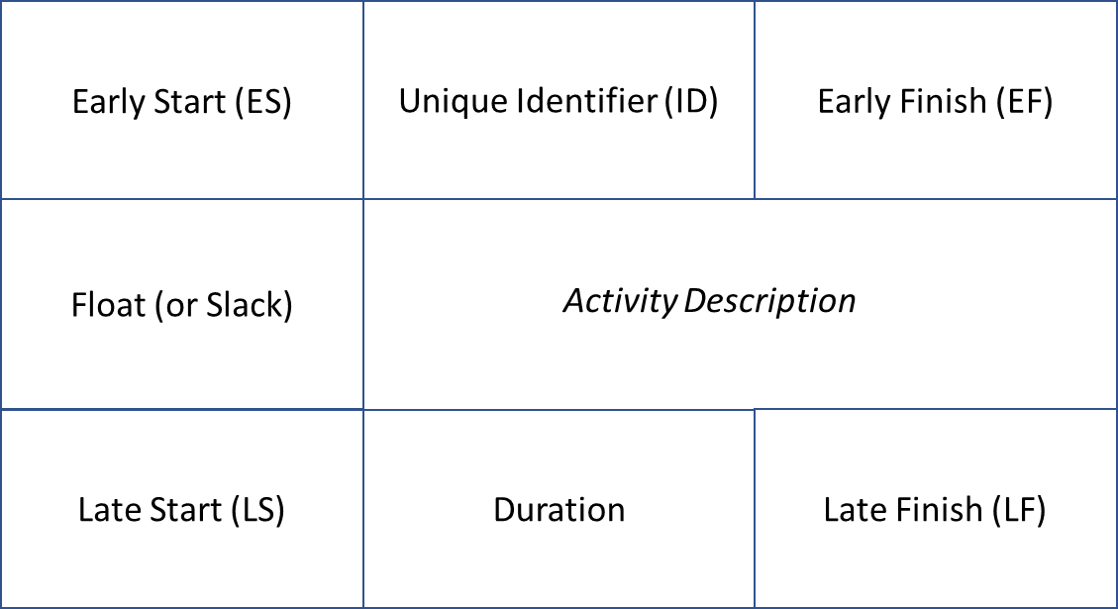
ACTIVITY ON NODE – THE NODE
Early start (ES): The earliest an activity can start.
It is the largest early finish of all immediate predecessors.
Late start (LS): The latest an activity can start and not delay the following activity/activities.
Early finish (EF): The earliest an activity can finish if all its preceding activities are finished by their early finish times.
Late finish (LF): The latest an activity can finish and not delay the following activity/activities.
Activity float (slack): The amount of time an activity may be delayed from its early start without delaying the finish of the project.
Identifier: The unique identifier for the activity (can be a letter)

Slide 36
AON – DRAWING THE DIAGRAM
Activity | Description | Predecessor
A | Contract signing | None
B | Questionnaire design | A
C | Target market ID | A
D | Survey sample | B, C
E | Develop presentation | B
F | Analyse results | D
G | Demographic analysis | C
H | Presentation to client | E, F, G

Slide 37
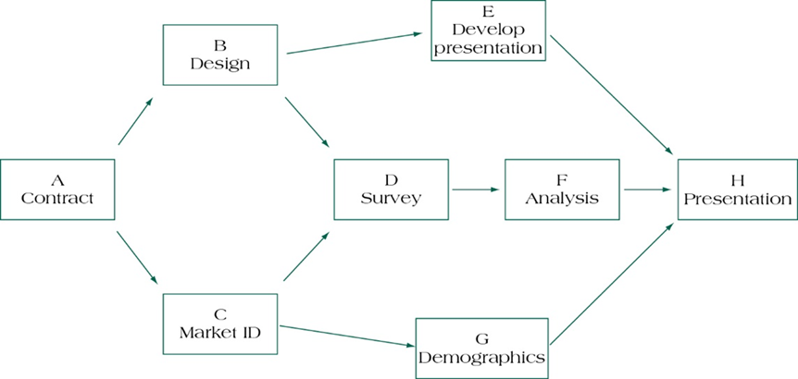
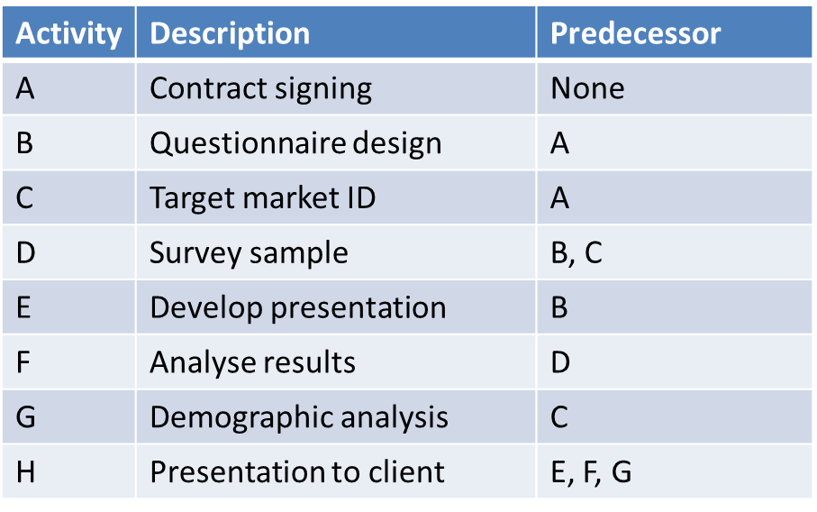
AON – DRAWING THE DIAGRAM

Slide 38
ACTIVITY DURATIONS
How might we figure out how long an activity could take?
Experience
Expert opinion
Mathematical derivation

Slide 39
ACTIVITY DURATIONS
How might we figure out how long an activity could take?
Experience
Expert opinion
Mathematical derivation
TE = estimated time (duration) of the activity
a = most optimistic time to complete the activity
m = most likely time to complete the activity
b = most pessimistic time to complete the activity

Slide 40
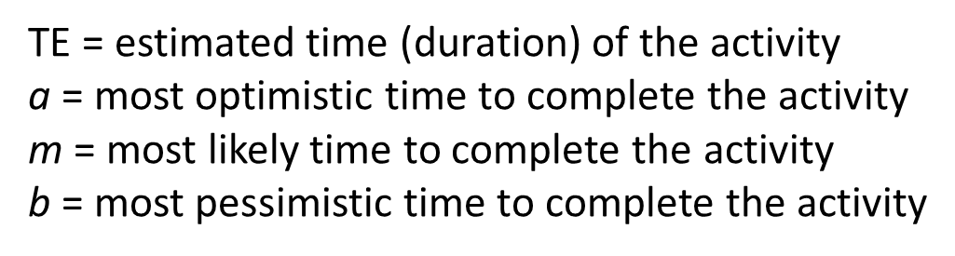
ACTIVITY DURATIONS
Activity | Description | Most optimistic (a) | Most likely (m) | Most pessimistic (b) | Activity Duration (TE)
A | Contract signing | 3 | 4 | 11
B | Questionnaire design | 2 | 5 | 8
C | Target market ID | 3 | 6 | 9
D | Survey sample | 8 | 12 | 20
E | Develop presentation | 3 | 5 | 12
F | Analyse results | 2 | 4 | 7
G | Demographic analysis | 6 | 9 | 14
H | Presentation to client | 1 | 2 | 4

Slide 41
ACTIVITY DURATIONS
Activity | Description | Most optimistic (a) | Most likely (m) | Most pessimistic (b) | Activity Duration (TE)
A | Contract signing | 3 | 4 | 11 | 5
B | Questionnaire design | 2 | 5 | 8 | 5
C | Target market ID | 3 | 6 | 9 | 6
D | Survey sample | 8 | 12 | 20 | 12.7 (13)
E | Develop presentation | 3 | 5 | 12 | 5.8 (6)
F | Analyse results | 2 | 4 | 7 | 4.2 (4)
G | Demographic analysis | 6 | 9 | 14 | 9.3 (9)
H | Presentation to client | 1 | 2 | 4 | 2.2 (2)

Slide 42
AON – DRAWING THE DIAGRAM
Activity | Description | Predecessor | Duration
A | Contract signing | None | 5
B | Questionnaire design | A | 5
C | Target market ID | A | 6
D | Survey sample | B, C | 13
E | Develop presentation | B | 6
F | Analyse results | D | 4
G | Demographic analysis | C | 9
H | Presentation to client | E, F, G | 2

Slide 43
AON – DRAWING THE DIAGRAM
Activity | Predecessor | Duration
A | None | 5
B | A | 5
C | A | 6
D | B, C | 13
E | B | 6
F | D | 4
G | C | 9
H | E, F, G | 2

Slide 44
AON – DRAWING THE DIAGRAM

Slide 45
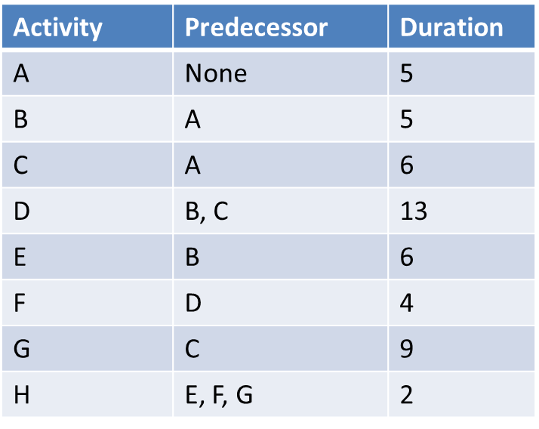
AON:
DRAWING THE DIAGRAM
E
B
A
D
F
H
C
G

Slide 46
AON:
DRAWING THE DIAGRAM
E
 | E
 | 6
B
 | B
 | 5
 | F
 | 4
 | H
 | 2
 | D
 | 13
F
H
 | A
 | 5
D
A
 | C
 | 6
C
G
 | G
 | 9

Slide 47
AON – FILLING IN THE ACTIVITY NODES
How soon can our activities start? (ES)
How soon can each activity end? (EF)
How soon can the project be finished? (TE)
How late can the activity start? (LS)
How late can the activity finish? (LF)
Which activities represent the critical path? (CP)
[the longest path which, when delayed, will delay the project]
How long can each activity be delayed? (float)

Slide 48
AON – FILLING IN THE ACTIVITY NODES
How soon can our activities start? (ES)
How soon can each activity end? (EF)
How soon can the project be finished? (TE)
How late can the activity start? (LS)
How late can the activity finish? (LF)
Which activities represent the critical path? (CP)
[the longest path which, when delayed,
will delay the project]
How long can each activity be delayed? (float)
Forward Pass
Backward Pass

Slide 49
Forward pass: Network calculations to determine earliest start & earliest finish for an activity through working forward through each activity in network.
AON – FORWARD PASS RULES
Add all activity times along each path as we move through the network (ES + Dur = EF).
Carry the EF time to the activity nodes immediately succeeding the recently completed node. That EF becomes the ES of the next node, unless the succeeding node is a merge point.
At a merge point, the largest preceding EF becomes the ES for that node
When we complete the forward pass we can calculate all ES, EF, and project TE

Slide 50
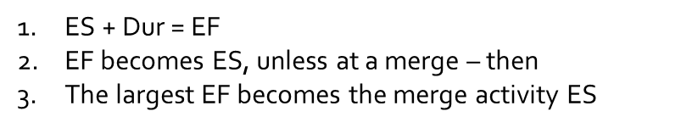
AON:
FORWARD PASS
E
10 | E | 16
 | 6
B
5 | B | 10
 | 5
24 | F | 28
 | 4
28 | H | 30
 | 2
11 | D | 24
 | 13
F
H
0 | A | 5
 | 5
D
A
5 | C | 11
 | 6
C
G
11 | G | 20
 | 9

Slide 51
Backward pass: Network calculations to determine late start/late finish for uncompleted tasks through working backward through each activity
AON – BACKWARD PASS RULES
Subtract activity times along each path as you move through the network (LF – Dur = LS).
Carry back the LS time to the activity nodes immediately preceding the successor node. That LS becomes the LF of the next node, unless the preceding node is a burst point.
In the case of a burst point, the smallest succeeding LS becomes the LF for that node.
When we complete the forward pass we can calculate all LS, LF, and float

Slide 52
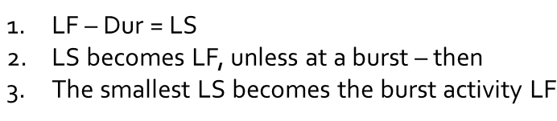
AON:
BACKWARD PASS
E
10 | E | 16
22 | 6 | 28
B
5 | B | 10
6 | 5 | 11
24 | F | 28
24 | 4 | 28
28 | H | 30
28 | 2 | 30
11 | D | 24
11 | 13 | 24
F
H
0 | A | 5
0 | 5 | 5
D
A
5 | C | 11
5 | 6 | 11
C
G
11 | G | 20
19 | 9 | 28

Slide 53
LF – EF = Float
LS – ES = Float
AON:
FLOAT
E
10 | E | 16
12
22 | 6 | 28
B
5 | B | 10
1
6 | 5 | 11
24 | F | 28
0
24 | 4 | 28
28 | H | 30
0
28 | 2 | 30
11 | D | 24
0
11 | 13 | 24
F
H
0 | A | 5
0
0 | 5 | 5
D
A
5 | C | 11
0
5 | 6 | 11
C
G
11 | G | 20
8
19 | 9 | 28
Activity Float/Slack: The amount of time that a schedule activity can be delayed without delaying the early start date to any immediately following schedule activities.

Slide 54
AON – CRITICAL PATH
Critical path: The path through project network with the longest duration.
Critical Path Method: A network analysis technique used to determine the amount of schedule flexibility on logical network paths in project schedule network and to determine minimum project duration

Slide 55
What are our different paths?
How long are they?
Which is our Critical Path?
AON:
CRITICAL PATH
E
10 | E | 16
12
22 | 6 | 28
B
5 | B | 10
1
6 | 5 | 11
24 | F | 28
0
24 | 4 | 28
28 | H | 30
0
28 | 2 | 30
11 | D | 24
0
11 | 13 | 24
F
H
0 | A | 5
0
0 | 5 | 5
D
A
5 | C | 11
0
5 | 6 | 11
C
G
11 | G | 20
8
19 | 9 | 28
A-B-E-H = 18 days

Slide 56
What are our different paths?
How long are they?
Which is our Critical Path?
AON:
CRITICAL PATH
E
10 | E | 16
12
22 | 6 | 28
B
5 | B | 10
1
6 | 5 | 11
24 | F | 28
0
24 | 4 | 28
28 | H | 30
0
28 | 2 | 30
11 | D | 24
0
11 | 13 | 24
F
H
0 | A | 5
0
0 | 5 | 5
D
A
5 | C | 11
0
5 | 6 | 11
C
G
11 | G | 20
8
19 | 9 | 28
A-B-E-H = 18 days
A-B-D-F-H = 29 days

Slide 57
What are our different paths?
How long are they?
Which is our Critical Path?
AON:
CRITICAL PATH
E
10 | E | 16
12
22 | 6 | 28
B
5 | B | 10
1
6 | 5 | 11
24 | F | 28
0
24 | 4 | 28
28 | H | 30
0
28 | 2 | 30
11 | D | 24
0
11 | 13 | 24
F
H
0 | A | 5
0
0 | 5 | 5
D
A
5 | C | 11
0
5 | 6 | 11
C
G
11 | G | 20
8
19 | 9 | 28
A-B-E-H = 18 days
A-B-D-F-H = 29 days
A-C-D-F-H = 30 days
Notes:
Path A-C-D-F-H takes 30 days

Slide 58
What are our different paths?
How long are they?
Which is our Critical Path?
AON:
CRITICAL PATH
E
10 | E | 16
12
22 | 6 | 28
B
5 | B | 10
1
6 | 5 | 11
24 | F | 28
0
24 | 4 | 28
28 | H | 30
0
28 | 2 | 30
11 | D | 24
0
11 | 13 | 24
F
H
0 | A | 5
0
0 | 5 | 5
D
A
5 | C | 11
0
5 | 6 | 11
C
G
11 | G | 20
8
19 | 9 | 28
A-B-E-H = 18 days
A-B-D-F-H = 29 days
A-C-D-F-H = 30 days
A-C-G-H = 22 days

Slide 59
What are our different paths?
How long are they?
Which is our Critical Path?
AON:
CRITICAL PATH
E
10 | E | 16
12
22 | 6 | 28
B
5 | B | 10
1
6 | 5 | 11
24 | F | 28
0
24 | 4 | 28
28 | H | 30
0
28 | 2 | 30
11 | D | 24
0
11 | 13 | 24
F
H
0 | A | 5
0
0 | 5 | 5
D
A
5 | C | 11
0
5 | 6 | 11
C
G
11 | G | 20
8
19 | 9 | 28
A-B-E-H = 18 days
A-B-D-F-H = 29 days
A-C-D-F-H = 30 days
A-C-G-H = 22 days

Slide 60
Project Scheduling:
Crashing the Project

Slide 61
RECALL: PROJECT SCHEDULING
Represents the conversion of project goals into an achievable methodology for their completion; a timetable and the network logic that relates project activities to each other in a coherent fashion
Clearly illustrates the interdependence of all tasks and work packages
Helps with master scheduling of organizational resources
Identification of critical activities & distinguishes them from the less critical
Provides expectation for when the project will be completed & dates on which various project activities must start & end
Helps with coordination of activities that are dependent on
each other

Slide 62
REDUCING THE CRITICAL PATH
When might we want to accelerate a project’s finish time?
The initial schedule may be too aggressive – we may have scheduled the project with a series of activity durations so condensed that crashing the project is inevitable
Market needs change and the completion of the project is required earlier than anticipated
The project has slipped significantly behind schedule
The contractual situation provides more incentive to avoid schedule slippage (e.g., late delivery penalties)
The process of accelerating a project is referred to as crashing

Slide 63
CRASHING THE PROJECT
The process of accelerating a project
Primary methods for crashing:
Improving existing resources’ productivity
Changing work methods
Compromise quality and/or reduce project scope
Institute fast-tracking
Work overtime
Increasing the quantity of resources

Slide 64
CRASHING THE PROJECT
The process of accelerating a project
Primary methods for crashing:
Improving existing resources’ productivity
Changing work methods
Compromise quality and/or reduce project scope
Institute fast-tracking
Work overtime
Increasing the quantity of resources

Slide 65
CRASHING THE PROJECT
The process of accelerating a project
Primary methods for crashing:
Improving existing resources’ productivity
Changing work methods
Compromise quality and/or reduce project scope
Institute fast-tracking
Work overtime
Increasing the quantity of resources

Slide 66
CRASHING THE PROJECT
The process of accelerating a project
Primary methods for crashing:
Improving existing resources’ productivity
Changing work methods
Compromise quality and/or reduce project scope
Institute fast-tracking
Work overtime
Increasing the quantity of resources

Slide 67
CRASHING THE PROJECT
The process of accelerating a project
Primary methods for crashing:
Improving existing resources’ productivity
Changing work methods
Compromise quality and/or reduce project scope
Institute fast-tracking
Work overtime
Increasing the quantity of resources

Slide 68
CRASHING THE PROJECT
The process of accelerating a project
Primary methods for crashing:
Improving existing resources’ productivity
Changing work methods
Compromise quality and/or reduce project scope
Institute fast-tracking
Work overtime
Increasing the quantity of resources

Slide 69
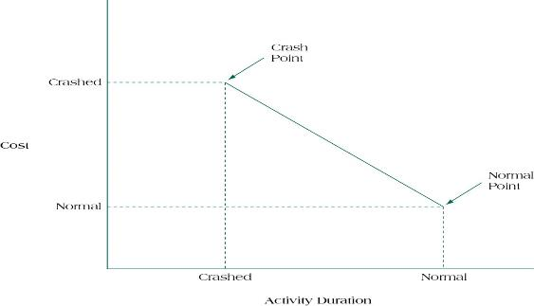
TIME/COST TRADE-OFF

Slide 70
TIME/COST TRADE-OFF

Slide 71
Slope = crash cost – normal cost
normal time - crash time
TIME/COST TRADE-OFF
We can calculate various combinations of time/cost trade-offs for a project’s crash options by calculating the slope for each activity

Slide 72
EXAMPLE
SUPPOSE:
NORMAL ACTIVITY DURATION = 8 WEEKS
NORMAL COST = $14,000
CRASHED ACTIVITY DURATION = 5 WEEKS
CRASHED COST = $23,000

Slide 73
EXAMPLE 1
SUPPOSE:
NORMAL ACTIVITY DURATION = 8 WEEKS
NORMAL COST = $14,000
CRASHED ACTIVITY DURATION = 5 WEEKS
CRASHED COST = $23,000
Slope = crash cost – normal cost
normal time - crash time

Slide 74
Slope = crash cost – normal cost
normal time - crash time
EXAMPLE 1
SUPPOSE:
NORMAL ACTIVITY DURATION = 8 WEEKS
NORMAL COST = $14,000
CRASHED ACTIVITY DURATION = 5 WEEKS
CRASHED COST = $23,000
Slope = $23,000 – $14,000
8 weeks – 5 weeks
Slope = $9,000/3weeks

Slide 75
Slope = crash cost – normal cost
normal time - crash time
EXAMPLE 1
SUPPOSE:
NORMAL ACTIVITY DURATION = 8 WEEKS
NORMAL COST = $14,000
CRASHED ACTIVITY DURATION = 5 WEEKS
CRASHED COST = $23,000
Slope = $23,000 – $14,000
8 weeks – 5 weeks
Slope = $9,000/3weeks
Slope = $3,000/week

Slide 76
Crashing the Project - Examples

Slide 77
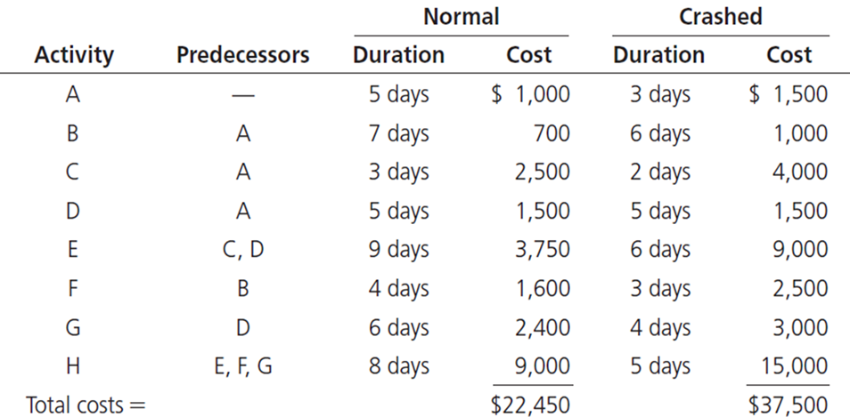
Suppose we have a project with the following 8 activities and we want to accelerate our project by crashing.
What do we need to do?
EXAMPLE 2

Slide 78
Suppose we have a project with the following 8 activities and we want to accelerate our project by crashing.
What do we need to do?
EXAMPLE 2

Slide 79
Suppose we have a project with the following 8 activities and we want to accelerate our project by crashing.
What do we need to do?
EXAMPLE 2

Slide 80
Suppose we have a project with the following 8 activities and we want to accelerate our project by crashing.
What do we need to do?
EXAMPLE 2

Slide 81
Suppose we have a project with the following 8 activities and we want to accelerate our project by crashing.
What do we need to do?
EXAMPLE 2

Slide 82
Suppose we have a project with the following 8 activities and we want to accelerate our project by crashing.
What do we need to do?
EXAMPLE 2

Slide 83
Slope = crash cost – normal cost
normal time - crash time
EXAMPLE 2
Which activities are optimal for crashing?
1) Calculate the crash cost of each activity (slope)
2) Decide which activities we should crash

Slide 84
Slope = crash cost – normal cost
normal time - crash time
EXAMPLE 2
Which activities are optimal for crashing?
1) Calculate the crash cost of each activity (slope)
2) Decide which activities we should crash

Slide 85
What is the critical path?
How many days is it?
EXAMPLE 2
E
 | F
 | 4
B
 | B
 | 7
 | H
 | 8
 | A
 | 5
 | E
 | 9
H
A
 | C
 | 3
 | D
 | 5
 | G
 | 6

Slide 86
What is the critical path?
How many days is it?
A – D – E – H
27 days
EXAMPLE 2
E
 | F
 | 4
B
 | B
 | 7
 | H
 | 8
 | A
 | 5
 | E
 | 9
H
A
 | C
 | 3
 | D
 | 5
 | G
 | 6

Slide 87

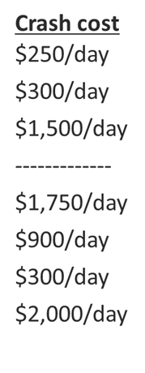
EXAMPLE 2
E
 | F
 | 4
B
 | B
 | 7
 | H
 | 8
 | A
 | 5
 | E
 | 9
H
A
 | C
 | 3
 | D
 | 5
 | G
 | 6

Slide 88
EXAMPLE 2
E
 | F
 | 4
B
 | B
 | 7
 | H
 | 8
 | A
 | 4
 | E
 | 9
H
A
 | C
 | 3
 | D
 | 5
 | G
 | 6

Slide 89
EXAMPLE 2
E
 | F
 | 4
B
 | B
 | 7
 | H
 | 8
 | A
 | 4
 | E
 | 9
H
A
 | C
 | 3
 | D
 | 5
 | G
 | 6

Slide 90
EXAMPLE 2
E
 | F
 | 4
B
 | B
 | 7
 | H
 | 8
 | A
 | 3
 | E
 | 9
H
A
 | C
 | 3
 | D
 | 5
 | G
 | 6

Slide 91
EXAMPLE 2
E
 | F
 | 4
A-B-F-H = 21
B
 | B
 | 6
A-C-E-H = 21
 | H
 | 8
 | A
 | 3
 | E
 | 9
H
A
 | C
 | 3
A-D-E-H = 25
 | D
 | 5
 | G
 | 5
A-D-E-H = 21

Slide 92
EXAMPLE 2
E
 | F
 | 4
B
 | B
 | 6
 | H
 | 8
 | A
 | 3
 | E
 | 9
H
A
 | C
 | 3
 | D
 | 5
 | G
 | 5

Slide 93
EXAMPLE 2
E
 | F
 | 4
B
 | B
 | 6
 | H
 | 8
 | A
 | 3
 | E
 | 9
H
A
 | C
 | 3
 | D
 | 5
 | G
 | 5

Slide 94
EXAMPLE 2
E
 | F
 | 4
B
 | B
 | 6
 | H
 | 8
 | A
 | 3
 | E
 | 8
H
A
 | C
 | 3
 | D
 | 5
 | G
 | 5

Slide 95
EXAMPLE 2
E
 | F
 | 4
A-B-F-H = 21
B
 | B
 | 6
A-C-E-H = 21
 | H
 | 8
 | A
 | 3
 | E
 | 8
H
A
 | C
 | 3
A-D-E-H = 24
 | D
 | 5
 | G
 | 5
A-D-E-H = 21

Slide 96
EXAMPLE 2
E
 | F
 | 4
A-B-F-H = 21
B
 | B
 | 6
A-C-E-H = 21
 | H
 | 8
 | A
 | 3
 | E
 | 6
H
A
 | C
 | 3
A-D-E-H = 22
 | D
 | 5
 | G
 | 5
A-D-E-H = 21

Slide 97
EXAMPLE 2
E
 | F
 | 4
B
 | B
 | 6
 | H
 | 8
 | A
 | 3
 | E
 | 6
H
A
 | C
 | 3
 | D
 | 5
 | G
 | 5

Slide 98
EXAMPLE 2
E
 | F
 | 4
B
 | B
 | 6
 | H
 | 5
 | A
 | 3
 | E
 | 6
H
A
 | C
 | 3
 | D
 | 5
 | G
 | 5

Slide 99
EXAMPLE 2
E
 | F
 | 4
A-B-F-H = 18
B
 | B
 | 6
A-C-E-H = 17
 | H
 | 5
 | A
 | 3
 | E
 | 6
H
A
 | C
 | 3
A-D-E-H = 19
 | D
 | 5
 | G
 | 5
A-D-E-H = 18

Slide 100
Recall:
normal cost = $22,450
normal time = 27 days
EXAMPLE 2
Critical path activities we can crash | Project duration | Project cost
 | 27 days | $22,450
A (2 days @ $250/day) | 26 days 25 days | $22,700 $22,950
E (3 days @ $1,750/day) | 24 days 23 days 22 days | $24,700 $26,450 $28,200
H (3 days @ $2,000/day) | 21 days 20 days 19 days | $30,200 $32,200 $24,200

Slide 101
Recall:
normal cost = $22,450
normal time = 27 days
EXAMPLE 2
Critical path activities we can crash | Project duration | Project cost
 | 27 days | $22,450
A (2 days @ $250/day) | 26 days 25 days | $22,700 $22,950
E (3 days @ $1,750/day) | 24 days 23 days 22 days | $24,700 $26,450 $28,200
H (3 days @ $2,000/day) | 21 days 20 days 19 days | $30,200 $32,200 $24,200

Slide 102
Recall:
normal cost = $22,450
normal time = 27 days
EXAMPLE 2
Critical path activities we can crash | Project duration | Project cost
 | 27 days | $22,450
A (2 days @ $250/day) | 26 days 25 days | $22,700 $22,950
E (3 days @ $1,750/day) | 24 days 23 days 22 days | $24,700 $26,450 $28,200
H (3 days @ $2,000/day) | 21 days 20 days 19 days | $30,200 $32,200 $24,200
A x 1 day

Slide 103
Recall:
normal cost = $22,450
normal time = 27 days
EXAMPLE 2
Critical path activities we can crash | Project duration | Project cost
 | 27 days | $22,450
A (2 days @ $250/day) | 26 days 25 days | $22,700 $22,950
E (3 days @ $1,750/day) | 24 days 23 days 22 days | $24,700 $26,450 $28,200
H (3 days @ $2,000/day) | 21 days 20 days 19 days | $30,200 $32,200 $24,200
A x 1 day
A x 1 day
E x 1 day
E x 1 day

Slide 104
The cost of crashing a project must always be considered against the time saved in expediting the activity’s schedule.
Assume the critical path is
A-C-D-H (57 days)
EXAMPLE 3
 | Normal |  | Crashed
Activity | Cost | Duration | Extra Cost | Duration | Crash Cost
A | $2,000 | 10 days | $2,000 | 7 days | $667/day
B | $1,500 | 5 days | $3,000 | 3 days | $1,500/day
C | $3,000 | 12 days | $1,500 | 9 days | $500/day
D | $5,000 | 20 days | $3,000 | 15 days | $600/day
E | $2,500 | 8 days | $2,500 | 6 days | $1,250/day
F | $3,000 | 14 days | $2,500 | 10 days | $625/day
G | $6,000 | 12 days | $5,000 | 10 days | $2,500/day
H | $9,000 | 15 days | $3,000 | 12 days | $1,000/day

Slide 105
The cost of crashing a project must always be considered against the time saved in expediting the activity’s schedule.
Assume the critical path is
A-C-D-H (57 days)
EXAMPLE 3
 | Normal |  | Crashed
Activity | Cost | Duration | Extra Cost | Duration | Crash Cost
A | $2,000 | 10 days | $2,000 | 7 days | $667/day
B | $1,500 | 5 days | $3,000 | 3 days | $1,500/day
C | $3,000 | 12 days | $1,500 | 9 days | $500/day
D | $5,000 | 20 days | $3,000 | 15 days | $600/day
E | $2,500 | 8 days | $2,500 | 6 days | $1,250/day
F | $3,000 | 14 days | $2,500 | 10 days | $625/day
G | $6,000 | 12 days | $5,000 | 10 days | $2,500/day
H | $9,000 | 15 days | $3,000 | 12 days | $1,000/day

Slide 106
The cost of crashing a project must always be considered against the time saved in expediting the activity’s schedule.
Assume the critical path is
A-C-D-H (57 days)
EXAMPLE 3
 | Normal |  | Crashed
Activity | Cost | Duration | Extra Cost | Duration | Crash Cost
A | $2,000 | 10 days | $2,000 | 7 days | $667/day
B | $1,500 | 5 days | $3,000 | 3 days | $1,500/day
C | $3,000 | 12 days | $1,500 | 9 days | $500/day
D | $5,000 | 20 days | $3,000 | 15 days | $600/day
E | $2,500 | 8 days | $2,500 | 6 days | $1,250/day
F | $3,000 | 14 days | $2,500 | 10 days | $625/day
G | $6,000 | 12 days | $5,000 | 10 days | $2,500/day
H | $9,000 | 15 days | $3,000 | 12 days | $1,000/day

Slide 107
The cost of crashing a project must always be considered against the time saved in expediting the activity’s schedule.
Assume the critical path is
A-C-D-H (57 days)
EXAMPLE 3
 | Normal |  | Crashed
Activity | Cost | Duration | Extra Cost | Duration | Crash Cost
A | $2,000 | 10 days | $2,000 | 7 days | $667/day
B | $1,500 | 5 days | $3,000 | 3 days | $1,500/day
C | $3,000 | 12 days | $1,500 | 9 days | $500/day
D | $5,000 | 20 days | $3,000 | 15 days | $600/day
E | $2,500 | 8 days | $2,500 | 6 days | $1,250/day
F | $3,000 | 14 days | $2,500 | 10 days | $625/day
G | $6,000 | 12 days | $5,000 | 10 days | $2,500/day
H | $9,000 | 15 days | $3,000 | 12 days | $1,000/day

Slide 108
The cost of crashing a project must always be considered against the time saved in expediting the activity’s schedule.
Assume the critical path is
A-C-D-H (57 days)
EXAMPLE 3
 | Normal |  | Crashed
Activity | Cost | Duration | Extra Cost | Duration | Crash Cost
A | $2,000 | 10 days | $2,000 | 7 days | $667/day
B | $1,500 | 5 days | $3,000 | 3 days | $1,500/day
C | $3,000 | 12 days | $1,500 | 9 days | $500/day
D | $5,000 | 20 days | $3,000 | 15 days | $600/day
E | $2,500 | 8 days | $2,500 | 6 days | $1,250/day
F | $3,000 | 14 days | $2,500 | 10 days | $625/day
G | $6,000 | 12 days | $5,000 | 10 days | $2,500/day
H | $9,000 | 15 days | $3,000 | 12 days | $1,000/day

Slide 109
The cost of crashing a project must always be considered against the time saved in expediting the activity’s schedule.
Assume the critical path is
A-C-D-H (57 days)
EXAMPLE 3
 | Normal |  | Crashed
Activity | Cost | Duration | Extra Cost | Duration | Crash Cost
A | $2,000 | 10 days | $2,000 | 7 days | $667/day
B | $1,500 | 5 days | $3,000 | 3 days | $1,500/day
C | $3,000 | 12 days | $1,500 | 9 days | $500/day
D | $5,000 | 20 days | $3,000 | 15 days | $600/day
E | $2,500 | 8 days | $2,500 | 6 days | $1,250/day
F | $3,000 | 14 days | $2,500 | 10 days | $625/day
G | $6,000 | 12 days | $5,000 | 10 days | $2,500/day
H | $9,000 | 15 days | $3,000 | 12 days | $1,000/day

Slide 110
The cost of crashing a project must always be considered against the time saved in expediting the activity’s schedule.
Assume the critical path is
A-C-D-H (57 days)
EXAMPLE 3
 | Normal |  | Crashed
Activity | Cost | Duration | Extra Cost | Duration | Crash Cost
A | $2,000 | 10 days | $2,000 | 7 days | $667/day
B | $1,500 | 5 days | $3,000 | 3 days | $1,500/day
C | $3,000 | 12 days | $1,500 | 9 days | $500/day
D | $5,000 | 20 days | $3,000 | 15 days | $600/day
E | $2,500 | 8 days | $2,500 | 6 days | $1,250/day
F | $3,000 | 14 days | $2,500 | 10 days | $625/day
G | $6,000 | 12 days | $5,000 | 10 days | $2,500/day
H | $9,000 | 15 days | $3,000 | 12 days | $1,000/day

Slide 111
The cost of crashing a project must always be considered against the time saved in expediting the activity’s schedule.
Assume the critical path is
A-C-D-H (57 days)
EXAMPLE 3
 | Normal |  | Crashed
Activity | Cost | Duration | Extra Cost | Duration | Crash Cost
A | $2,000 | 10 days | $2,000 | 7 days | $667/day
B | $1,500 | 5 days | $3,000 | 3 days | $1,500/day
C | $3,000 | 12 days | $1,500 | 9 days | $500/day
D | $5,000 | 20 days | $3,000 | 15 days | $600/day
E | $2,500 | 8 days | $2,500 | 6 days | $1,250/day
F | $3,000 | 14 days | $2,500 | 10 days | $625/day
G | $6,000 | 12 days | $5,000 | 10 days | $2,500/day
H | $9,000 | 15 days | $3,000 | 12 days | $1,000/day

Slide 112
EXAMPLE 3
Total normal project days = 57 days
Also suppose that the project team will be charged the following:
Overhead at $200/day fixed rate
A series of late penalties will kick in if the project is not completed in 50 days
Balancing act:
At what point is it no longer economically viable to continue crashing activities?

Slide 113
EXAMPLE 3
Total normal project days = 57 days
Also suppose that the project team will be charged the following:
Overhead at $200/day fixed rate
A series of late penalties will kick in if the project is not completed in 50 days
Project duration | Direct costs | Late penalties | Overhead costs | Total costs
57 days (normal) | $32,000 (normal) | $5,000 | $11,400 | $48,400

Slide 114
EXAMPLE 3
Total normal project days = 57 days
Also suppose that the project team will be charged the following:
Overhead at $200/day fixed rate
A series of late penalties will kick in if the project is not completed in 50 days
Project duration | Direct costs | Late penalties | Overhead costs | Total costs
57 days (normal) | $32,000 (normal) | $5,000 | $11,400 | $48,400

Slide 115
EXAMPLE 3
Total normal project days = 57 days
Also suppose that the project team will be charged the following:
Overhead at $200/day fixed rate
A series of late penalties will kick in if the project is not completed in 50 days
Project duration | Direct costs | Late penalties | Overhead costs | Total costs
57 days (normal) | $32,000 (normal) | $5,000 | $11,400 | $48,400

Slide 116
EXAMPLE 3
Total normal project days = 57 days
Also suppose that the project team will be charged the following:
Overhead at $200/day fixed rate
A series of late penalties will kick in if the project is not completed in 50 days
Project duration | Direct costs | Late penalties | Overhead costs | Total costs
57 days (normal) | $32,000 (normal) | $5,000 | $11,400 | $48,400
54 days
51 days
48 days
Balancing act:
At what point is it no longer economically viable to continue crashing activities?

Slide 117
EXAMPLE 3
Total normal project days = 57 days
Also suppose that the project team will be charged the following:
Overhead at $200/day fixed rate
A series of late penalties will kick in if the project is not completed in 50 days
Project duration | Direct costs | Late penalties | Overhead costs | Total costs
57 days (normal) | $32,000 (normal) | $5,000 | $11,400 | $48,400
54 days | $33,500 (crashed C) | $3,000 | $10,800 | $47,300

Slide 118
EXAMPLE 3
Total normal project days = 57 days
Also suppose that the project team will be charged the following:
Overhead at $200/day fixed rate
A series of late penalties will kick in if the project is not completed in 50 days
Project duration | Direct costs | Late penalties | Overhead costs | Total costs
57 days (normal) | $32,000 (normal) | $5,000 | $11,400 | $48,400
54 days | $33,500 (crashed C) | $3,000 | $10,800 | $47,300
51 days | $35,500 (crashed A) | $1,000 | $10,200 | $46,700

Slide 119
EXAMPLE 3
Total normal project days = 57 days
Also suppose that the project team will be charged the following:
Overhead at $200/day fixed rate
A series of late penalties will kick in if the project is not completed in 50 days
Project duration | Direct costs | Late penalties | Overhead costs | Total costs
57 days (normal) | $32,000 (normal) | $5,000 | $11,400 | $48,400
54 days | $33,500 (crashed C) | $3,000 | $10,800 | $47,300
51 days | $35,500 (crashed A) | $1,000 | $10,200 | $46,700
48 days | $38,500 (crashed H) | $0 | $9,600 | $48,100

Slide 120
Project Scheduling:
Gantt Charts

Slide 121
GANTT CHARTS
Establish a time-phased network
Can be used as a tracking tool
Benefits of Gantt charts
Easy to comprehend
Identify the schedule baseline network
Allow for updating and control
Identify resource needs
Easy to create

Slide 122
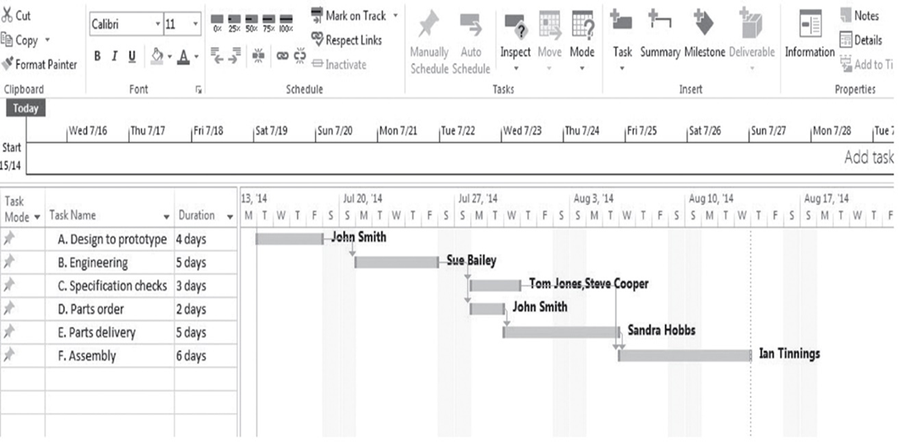
GANTT CHARTS

Slide 123
GANTT CHARTS

Slide 124
GANTT CHARTS

Slide 125
GANTT CHARTS

Slide 126
GANTT CHARTS

Slide 127
GANTT CHARTS

Slide 128
GANTT CHARTS

Slide 129
GANTT CHARTS

Slide 130
EXAMPLE
Activity | Pred. | Duration
A | None | 5
B | A | 5
C | A | 6
D | B, C | 13
E | B | 6
F | D | 4
G | C | 9
H | E, F, G | 2

Slide 131
EXAMPLE
Activity | Pred. | Duration
A | None | 5
B | A | 5
C | A | 6
D | B, C | 13
E | B | 6
F | D | 4
G | C | 9
H | E, F, G | 2

Slide 132
EXAMPLE
Activity | Pred. | Duration
A | None | 5
B | A | 5
C | A | 6
D | B, C | 13
E | B | 6
F | D | 4
G | C | 9
H | E, F, G | 2

Slide 133
EXAMPLE
Activity | Pred. | Duration
A | None | 5
B | A | 5
C | A | 6
D | B, C | 13
E | B | 6
F | D | 4
G | C | 9
H | E, F, G | 2

Slide 134
EXAMPLE
Activity | Pred. | Duration
A | None | 5
B | A | 5
C | A | 6
D | B, C | 13
E | B | 6
F | D | 4
G | C | 9
H | E, F, G | 2

Slide 135
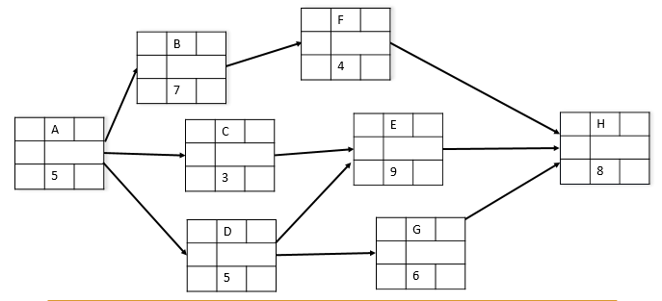
EXAMPLE
Activity | Pred. | Duration
A | None | 5
B | A | 5
C | A | 6
D | B, C | 13
E | B | 6
F | D | 4
G | C | 9
H | E, F, G | 2

Slide 136
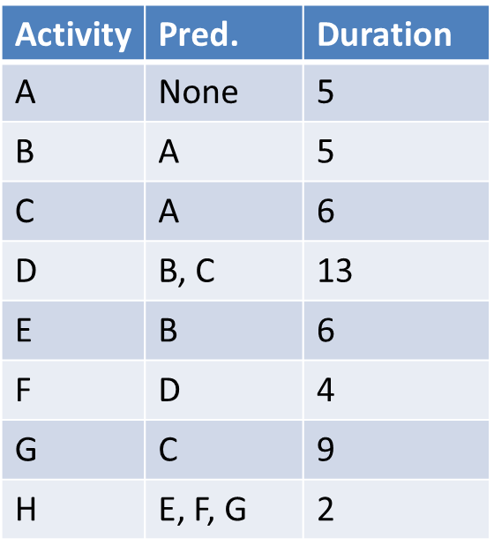
EXAMPLE
0
5
10
15
20
25
30
A
B
C
D
E
F
G
H

Slide 137
EXAMPLE
0
5
10
15
20
25
30
A
B
C
D
E
F
G
H

Slide 138
EXAMPLE
0
5
10
15
20
25
30
A
B
C
D
E
F
G
H

Slide 139
EXAMPLE
0
5
10
15
20
25
30
A
B
C
D
E
F
G
H

Slide 140
EXAMPLE
0
5
10
15
20
25
30
A
B
C
D
E
F
G
H

Slide 141
EXAMPLE
0
5
10
15
20
25
30
A
B
C
D
E
F
G
H

Slide 142
EXAMPLE
0
5
10
15
20
25
30
A
B
C
D
E
F
G
H

Slide 143
EXAMPLE
0
5
10
15
20
25
30
A
B
C
D
E
F
G
H

Slide 144
EXAMPLE
0
5
10
15
20
25
30
A
B
C
D
E
F
G
H

Slide 145
EXAMPLE
0
5
10
15
20
25
30
A
B
C
D
E
F
G
H

Slide 146
EXAMPLE
0
5
10
15
20
25
30
A
B
C
D
E
F
G
H

Slide 147
EXAMPLE
0
5
10
15
20
25
30
A
B
C
D
E
F
G
H

Slide 148
EXAMPLE
0
5
10
15
20
25
30
A
B
C
D
E
F
G
H

Slide 149
EXAMPLE
0
5
10
15
20
25
30
A
B
C
D
E
F
G
H

Slide 150
EXAMPLE
0
5
10
15
20
25
30
A
B
C
D
E
F
G
H

Slide 151
EXAMPLE
0
5
10
15
20
25
30
A
B
C
D
E
F
G
H

Slide 152
EXAMPLE
0
5
10
15
20
25
30
A
B
C
D
E
F
G
H

Slide 153
EXAMPLE
0
5
10
15
20
25
30
A
B
C
D
E
F
G
H

Slide 154
EXAMPLE
0
5
10
15
20
25
30
A
B
C
D
E
F
G
H

Slide 155
Project Monitoring, Control, & Evaluation

Slide 156
MONITORING AND CONTROL
One of the most significant challenges of running a project – maintaining accurate monitoring and control systems for its implementation
Project monitoring and control are principal mechanisms to helps the project team stay on top of the project’s evolving status
“No news is good news” is not good enough – we need to clearly understand the benefits that can be derived from
careful and thorough status assessments as the project progresses

Slide 157
MONITORING AND CONTROL
We need to know what information should be measured and when the best time to measure it is
We want the information as soon as we can get it and we want it to be as up-to-date as possible
Systematic project control is comprehensive, accurate, & timely

Slide 158
MONITORING AND CONTROL
Data collected are determined by which metrics will be used for project control
Typical key data include actual activity duration, resource usage and rates, actual costs - compare against planned times, resources, budgets
A major portion of monitoring focuses on cost/schedule concerns – provide the PM and stakeholders with data to answer:
  What is the current status in terms of schedule and cost?
  When will the project be completed & how much will it cost?
  What, who, where are the causes for overruns?
  What did we get for the amount we spent?
  If there are overruns mid-way can we adjust our forecast?

Slide 159
PROJECT CONTROL CYCLES
General model of organizational control – four components that operate in a continuous cycle
Setting a goal
Measuring progress
Comparing actual With planned performance
Taking action
Control is the process of comparing actual performance against planned performance, to identify deviations, evaluate possible alternative courses of action, and take appropriate corrective action

Slide 160
PROJECT CONTROL CYCLES
1. Setting a goal
Setting the project plan / creating a WBS to establish all the deliverables & work packages that are associated with the project
2. Measuring progress
Need a system in place that will allow project managers to gather information as quickly as possible – need to clearly define what to measure

Slide 161
PROJECT CONTROL CYCLES
3. Comparing actual with planned performance
Perform a gap analysis to determine
the goals and the degree to which
the actual performance lives up to
those goals
4. Taking action
Once deviations are detected, we need to take corrective action (can be significant or minor), and then the cycle begins again

Slide 162
MONITORING PROJECT PERFORMANCE
Once we have established a project baseline budget, one of the most important methods for indicating the ongoing status of the project is to evaluate it against the original budget projections.
A major goal of progress reporting is to catch any negative variances from the original plan as early as possible to determine if any corrective action is required.

Slide 163
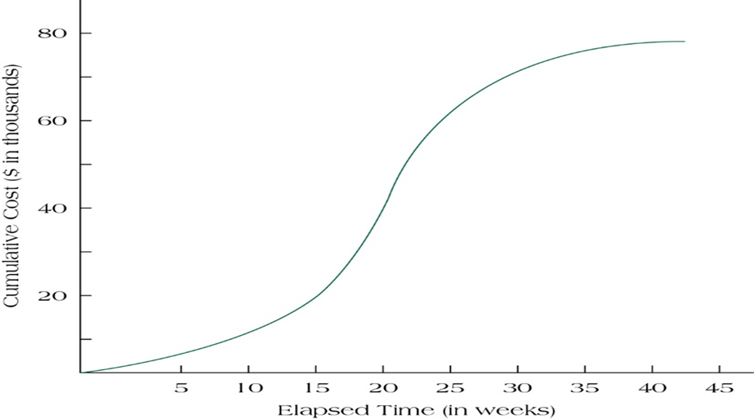
S-CURVE
Individual task budgets & overall project budget are important
A project S-curve represents the typical form of the relationship between the money expended and the time (time/cost analysis)
The S-curve represents
the project’s baseline
budget against which
actual budget
expenditures can be
evaluated
Copyright © 2016 Pearson Education, Ltd.

Slide 164
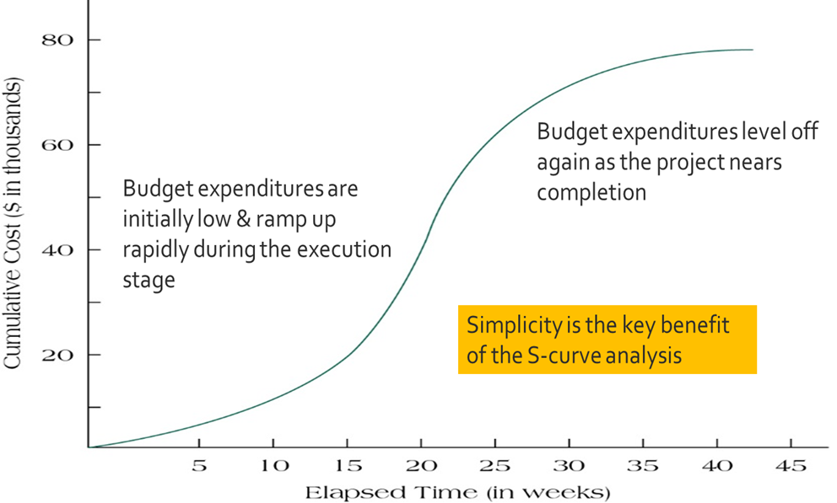
S-CURVE
Copyright © 2016 Pearson Education, Ltd.

Slide 165
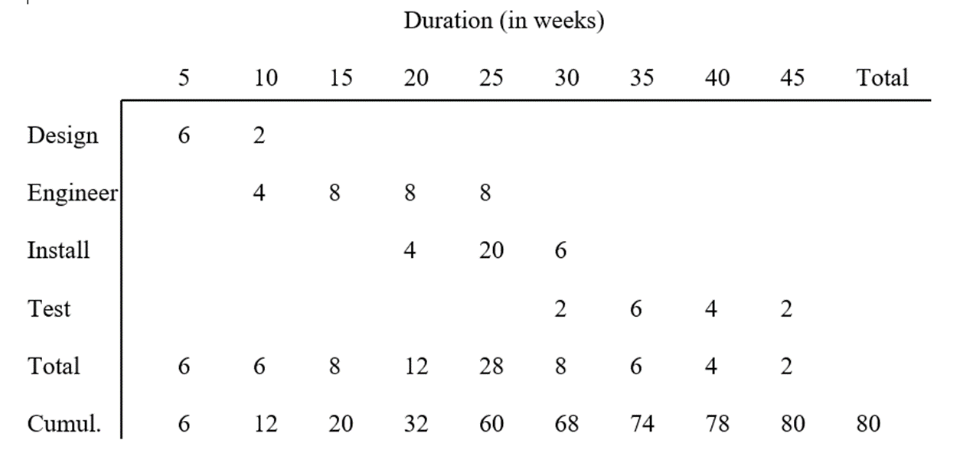
S-CURVE EXAMPLE
Four work packages = Design, Engineer, Install, Test
Project budget = $80,000
Project duration = 45 weeks

Slide 166
S-CURVE EXAMPLE
Four work packages = Design, Engineer, Install, Test
Project budget = $80,000
Project duration = 45 weeks

Slide 167
S-CURVE EXAMPLE
Four work packages = Design, Engineer, Install, Test
Project budget = $80,000
Project duration = 45 weeks

Slide 168
S-CURVE EXAMPLE
Four work packages = Design, Engineer, Install, Test
Project budget = $80,000
Project duration = 45 weeks

Slide 169

S-CURVE EXAMPLE

Slide 170
S-CURVE EXAMPLE
Suppose we want to check at week 21 how we are progressing with respect to our budget.

Slide 171
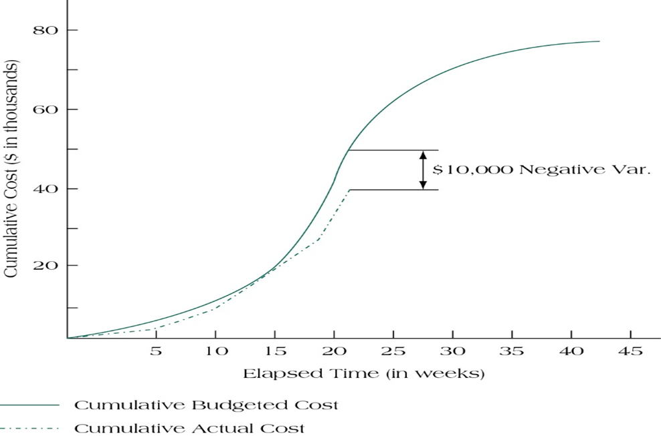
Suppose when we check at week 21 and find our actual project expenditure is cumulatively only $40,000 (supposed to be $50,000)
S-CURVE EXAMPLE

Slide 172
Suppose when we check at week 21 and find our actual project expenditure is cumulatively only $40,000 (supposed to be $50,000)
S-CURVE EXAMPLE
Quick visual for linking project costs (budgeted and actual) over the project’s schedule

Slide 173
Suppose when we check at week 21 and find our actual project expenditure is cumulatively only $40,000 (supposed to be $50,000)
S-CURVE EXAMPLE
Quick visual for linking project costs (budgeted and actual) over the project’s schedule
Does not allow us to make reasonable interpretations for the cause of the variance

Slide 174
Suppose when we check at week 21 and find our actual project expenditure is cumulatively only $40,000 (supposed to be $50,000)
S-CURVE EXAMPLE
Quick visual for linking project costs (budgeted and actual) over the project’s schedule
Does not allow us to make reasonable interpretations for the cause of the variance
Reactive data – we are plotting after the money has already been spent

Slide 175
MILESTONE ANALYSIS
Milestones are events or stages of the project that represent a significant accomplishment.
Completion of a deliverable (a combination of multiple tasks)
Important activity on the critical path
Calendar dates
Any ‘road marker’ along the project’s life cycle
Notes:
.

Slide 176
MILESTONE ANALYSIS
Milestones:
Signal completion of important steps
Motivate team and suppliers
Offer reevaluation points
Help coordinate schedules
Identify key review gates
Signal other team members when their participation begins
Delineate work packages

Slide 177
TRACKING GANTT CHART
Quite easy to understand
Visual nature of report is easy to assimilate and interpret
Sense of real-time project control
Not identifying the underlying source of problems
The reason for the slippage cannot be inferred from the data presented
Difficult to accurately estimate time to completion from a baseline schedule
Should be used in conjunction with other techniques

Slide 178
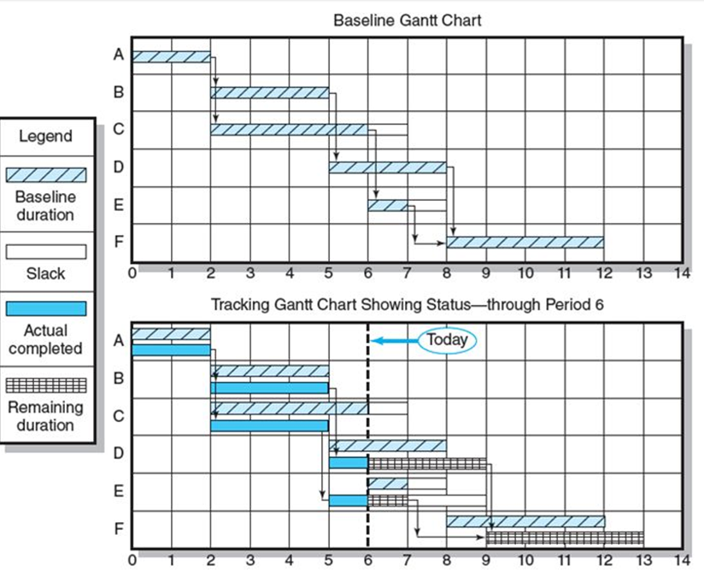
TRACKING GANTT CHART
Copyright © 2018 McGraw-Hill Education

Slide 179
EARNED VALUE MANAGEMENT
Cost
S-Curves
Time
179

Slide 180
EARNED VALUE MANAGEMENT
Cost
S-Curves
Milestones/Tracking Gantt
Scope (Performance)
Time
180

Slide 181
EARNED VALUE MANAGEMENT
Cost
S-Curves
Milestones/Tracking Gantt
Scope (Performance)
Time
181

Slide 182
EARNED VALUE MANAGEMENT
Cost
S-Curves
Milestones/Tracking Gantt
Earned Value Management
Scope (Performance)
Time
182

Slide 183
EARNED VALUE MANAGEMENT
Earned Value Management (EVM) recognizes that it is necessary to jointly consider the impact of time, cost, and project performance on any analysis of current project status
Earned Value (EV) directly links all three primary project success metrics (cost, schedule, and performance).

Slide 184
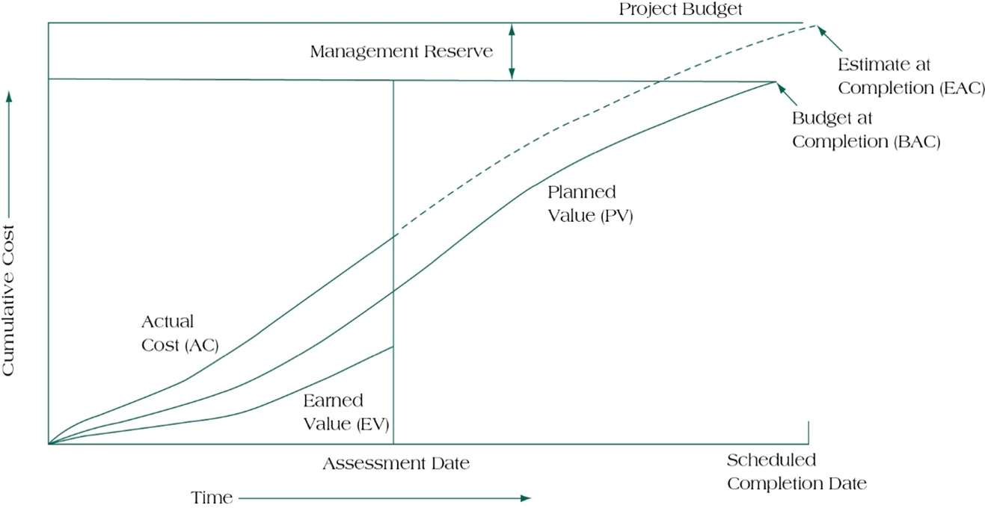
EARNED VALUE MANAGEMENT
Copyright © 2016 Pearson Education, Ltd.

Slide 185
EARNED VALUE MANAGEMENT
Copyright © 2016 Pearson Education, Ltd.

Slide 186
EARNED VALUE MANAGEMENT
Copyright © 2016 Pearson Education, Ltd.

Slide 187
EARNED VALUE MANAGEMENT
Copyright © 2016 Pearson Education, Ltd.

Slide 188
EARNED VALUE MANAGEMENT
Copyright © 2016 Pearson Education, Ltd.

Slide 189
EARNED VALUE MANAGEMENT
Copyright © 2016 Pearson Education, Ltd.

Slide 190
EVM EXAMPLE
Four work packages = Design, Engineer, Install, Test
Project budget = $80,000
Project duration = 45 weeks

Slide 191
Four work packages = Design, Engineer, Install, Test
Project budget = $80,000
Project duration = 45 weeks
EVM EXAMPLE
We know the baseline for how our project should perform, and now we can assess how we are actually doing. Assume we want to check how we are doing at week 30.

Slide 192
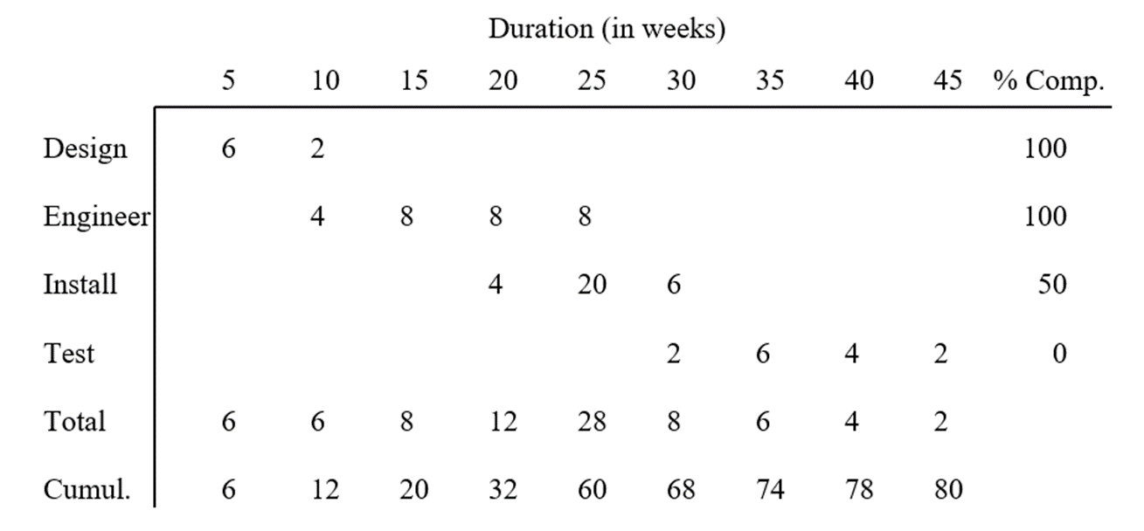
Four work packages = Design, Engineer, Install, Test
Project budget = $80,000
Project duration = 45 weeks
EVM EXAMPLE
We know the baseline for how our project should perform, and now we can assess how we are actually doing. Assume we want to check how we are doing at week 30.

Slide 193
Four work packages = Design, Engineer, Install, Test
Project budget = $80,000
Project duration = 45 weeks
EVM EXAMPLE
We know the baseline for how our project should perform, and now we can assess how we are actually doing. Assume we want to check how we are doing at week 30.

Slide 194
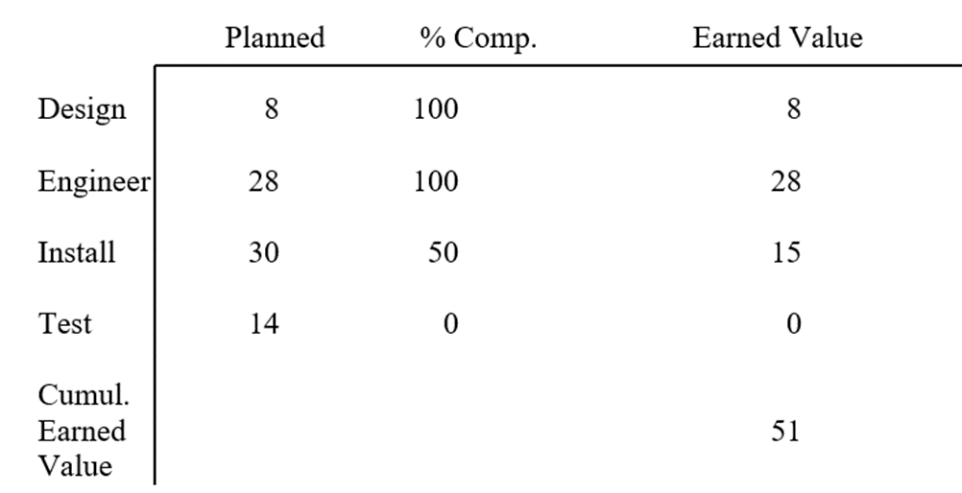
Planned budget is
multiplied by the
percentage completed
in order to determine
the earned value to
date for the work
packages.
EVM EXAMPLE
.
What is the status of this project in terms of budget, schedule, and performance? Focus exclusively on the relevant information for determining earned value as of week 30.

Slide 195
Planned budget is
multiplied by the
percentage completed
in order to determine
the earned value to
date for the work
packages.
EVM EXAMPLE
.
What is the status of this project in terms of budget, schedule, and performance? Focus exclusively on the relevant information for determining earned value as of week 30.

Slide 196
Planned budget is
multiplied by the
percentage completed
in order to determine
the earned value to
date for the work
packages.
EVM EXAMPLE
.
What is the status of this project in terms of budget, schedule, and performance? Focus exclusively on the relevant information for determining earned value as of week 30.

Slide 197
Planned budget is
multiplied by the
percentage completed
in order to determine
the earned value to
date for the work
packages.
EVM EXAMPLE
.
What is the status of this project in terms of budget, schedule, and performance? Focus exclusively on the relevant information for determining earned value as of week 30.

Slide 198
Planned budget is
multiplied by the
percentage completed
in order to determine
the earned value to
date for the work
packages.
EVM EXAMPLE
What is the status of this project in terms of budget, schedule, and performance? Focus exclusively on the relevant information for determining earned value as of week 30.
.
$8,000 x 100% = $8,000
$28,000 x 100% = $28,000
$30,000 x 50% = $15,000
Cumulative earned value = $51,000

Slide 199

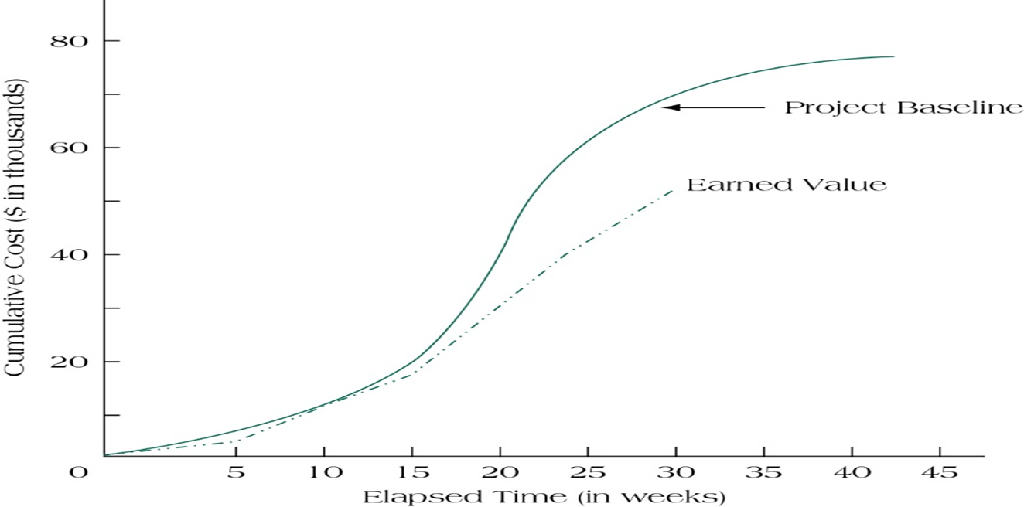
What is the status of this project in terms of budget, schedule, and performance?

